Slide 1
Motion Prediction Model
Group Members:
Cassandra Rose
Sarthak Sanjay Kore
Satya Teja Nimmakayala

Slide 2
Problem statement
Using machine learning, we hope to be able to predict the movement of other vehicles in the vicinity of a self-driving car.

Slide 3
Motivation
Over 30,000 people in the US are killed in car crashes every year. One of the central problems in the development of autonomous vehicles is the ability to predict the behavior of other entities around a vehicle. Autonomous vehicles need to be able to detect and plan for the position and movement of other vehicles in order to avoid accidents, both for the safety of their occupants and the vehicles around them.

Slide 4
Approach
This project will use a prediction dataset and library provided by Level 5.
This dataset consists of a timestamp of AVs which has a frame and agents.
This dataset will be fed to a convolution neural network (ResNet50), which will train the model and give us predictions. As the model reiterates, it becomes more precise.
After our initial system is functional, we will modify the model to determine what methods are best for making accurate predictions.

Slide 5
Methodology
The dataset required for this project is provided by Lytf.
We will be using this data, alongside a model based on ResNet50, pretrained on Imagenet.
Here, after training we will check the Loss with the help of Loss curve.
As for the evaluation process, it’s a bit different from training. We will need to “chop” the database, as when working with Time series, we have the future already predicted in it. So we slice it off of dataset.
As for the output, we get an output in the form of agents, that have space coordinates stored in them. We convert these into displacements in World space.

Slide 6
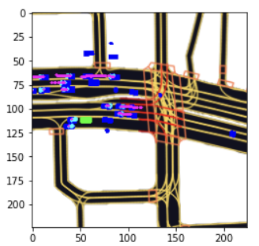
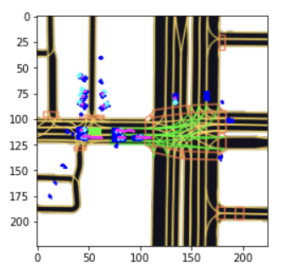
Results

Slide 7
Results Explained.
As seen from the previous slide, the output results indicate the prediction of trajectory of vehicles around Autonomous vehicles.
It tries to predict the motion of vehicles around it, so as to avoid any accident, same as a human driver would subconsciously do.
The more we train our model, the better it gets at predicting the trajectory of surrounding vehicles.

Slide 8
Conclusion
We have successfully implemented, coded and executed the project.
We have done so by training the dataset on ResNet50 model pretrained on imagenet.
Using the trained model, we are now able to predict the movement

Slide 9
Bibliography
Blog about motion prediction :
https://medium.com/wovenplanetlevel5/how-to-build-a-motion-prediction-model-for-autonomous-vehicles-29f7f81f1580
Dataset from “Lyft” :
https://self-driving.lyft.com/level5/prediction/

Slide 10
Thank You.
Any Questions?

